Slide 1
SC2001
Example Class 3
Dynamic Programming
Ivan Lim
Justin Chua
Chew You Chun
Notes:
Goood morning, I am Ivan together here with JUstin and You chun, today we are presenting on project 3

Slide 2
01
Problem Definition
02
Recursive Definition
03
Subproblem Graph
04
Dynamic Programming Algorithm
05
Running Results
Notes:
This is the table of contents,

Slide 3
01
Problem Definition
x
y
Notes:
and to begin lets take a look at the problem defination

Slide 4

Problem Definition
Notes:
So in the project are we given a knapsack with capacity weight C and n types of object, our goal is to find the maximum profit in which any set of objects that fits in the knapsack. One thing to point out its that we are given this condition in which there are unlimit supplies of each type of object. In other words, we can pick the same object more than once.

Slide 5
02
Recursive Definition
x
y
Notes:
So lets take e a look at the recursive function

Slide 6
Recursive Definition
Let P(C) be the maximum profit that can be made by selection of n objects with knapsack capacity C.
P(0) = 0
P(C) = max(P(C), P(C-W_{j}) + p_{j})
Where 0<= j <= n-1 and W_{j} <= C
Notes:
LEt P(C) be the maximum profit that can be made by selection of n objects with knapsack capacity C Base case -> when there the capacity of knapsack is 0. So function will return 0 if the base cases is met
As for the recursive part, for each item j we will pick the best item that contributes to the greatest amount of profit if it is picked given that the weight of the item is smaller than capacity.
In other words, for each C, we will find the
So our formula here W is the weights array while P is the profits array

Slide 7
03
Subproblem Graph
x
y

Slide 8
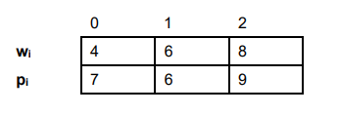
P(14)
P(10)
P(8)
P(6)
P(6)
P(4)
P(2)
P(4)
P(2)
P(0)
P(2)
P(0)
P(2)
P(0)
P(0)
P(0)
Notes:
Highlighted in red are base cases (2 in total)
Start from top with capacity of 14 as given in question
We have 3 items to consider, with weights 4, 6 and 8 respectively
This is true for every case afterwards as seen from remaining capacity 10, 8 and 6etc
If we choose not to take the item, we will move on to decide whether we want to take the next item (capacity remains at 14)
If we take item 3, our capacity will be reduced to 6 (14-8). Over here, if we choose to take item 3, our capacity will be exceeded (6-8). Hence, we only have the option to move on to see if we can take on the next item.
The dp algorithm will only stop when we reach either of the 2 base cases - when we reach capacity 0 or when we reach the 0th item (meaning all items have been considered)

Slide 9
04
Dynamic Programming Algorithm
x
y

Slide 10
Pseudocode
knapsack (weights, profits, C)
Calculate n as length of the weight array
Initialise profit array with (C+1) columns to 0
FOR c = 1 to C
FOR j = 0 to n-1
IF (weight of jth item <= c) THEN
profit[c] = max(profit[c-(weight of jth item)] + profit of jth item) OR (profit[c]))
ENDIF
ENDFOR
ENDFOR
RETURN profit[n-1]
Notes:
Using bottoms up approach
*(profit array is our own, profits is given array)
We first initialise our profit array (1D) with (C+1) column and set all values to 0.
We then iterate through every profit of C and we check for each individual item if the weight is less than the remaining capacity. If so, we will set the profit for that particular value of C as the one that gives us the highest profit amongst the n items.
Else, we dont take the item.
At the end we return profit[n-1], which holds the value of the maximum profit.

Slide 11
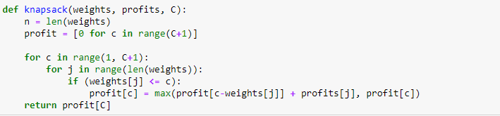
Code

Slide 12
05
Running Results
x
y

Slide 13
profit[c] = max(profit[c-w[j]] + p[j], profit[c])
C
0
1
2
3
4
5
6
7
8
9
10
11
12
13
14
profit
7
7
7
14
14
14
0
0
0
0
0
0
7
7
14
0
0
0
0
0
0
0
0
0
7
14
21
21
21
21
w[j] | profit[c-w[j]] + p[j],
4 | 0+7=7
6 | -
8 | -
w[j] | profit[c-w[j]] + p[j],
4 | 0+7=7
6 | 0+6=6
8 | -
w[j] | profit[c-w[j]] + p[j],
4 | 7+7=14
6 | 0+6=6
8 | 0+9=9
w[j] | profit[c-w[j]] + p[j],
4 | 14+7=21
6 | 7+6=13
8 | 7+9=16
w[j] | profit[c-w[j]] + p[j],
4 | 14+7=21
6 | 14+6=20
8 | 7+9=16

Slide 14
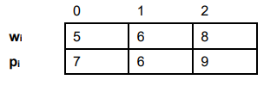
profit[c] = max(profit[c-w[j]] + p[j], profit[c])
C
0
1
2
3
4
5
6
7
8
9
10
11
12
13
14
0
profit
7
7
7
9
0
7
9
14
0
0
0
0
0
0
7
0
9
14
14
16
16
0
0
0
0
0
0
14
14
16
w[j] | profit[c-w[j]] + p[j],
5 | 0+7=7
6 | -
8 | -
w[j] | profit[c-w[j]] + p[j],
5 | 0+7=7
6 | 0+6=6
8 | -
w[j] | profit[c-w[j]] + p[j],
5 | 0+7=7
6 | 0+6=6
8 | 0+9=9
w[j] | profit[c-w[j]] + p[j],
5 | 7+7=14
6 | 0+6=6
8 | 0+9=9
w[j] | profit[c-w[j]] + p[j],
5 | 7+7=14
6 | 7+6=13
8 | 0+9=9
w[j] | profit[c-w[j]] + p[j],
5 | 9+7=16
6 | 7+6=13
8 | 7+9=16
w[j] | profit[c-w[j]] + p[j],
5 | 9+7=16
6 | 9+6=15
8 | 7+9=16

